Slide 1
BARANGAY RECORD SYSTEM
Created with a trial version of Syncfusion Essential Presentation
Created with a trial version of Syncfusion Essential Presentation
Created with a trial version of Syncfusion Essential Presentation
Created with a trial version of Syncfusion Essential Presentation
Created with a trial version of Syncfusion Essential Presentation
Created with a trial version of Syncfusion Essential Presentation
Created with a trial version of Syncfusion Essential Presentation
Created with a trial version of Syncfusion Essential Presentation
Created with a trial version of Syncfusion Essential Presentation
Created with a trial version of Syncfusion Essential Presentation
Created with a trial version of Syncfusion Essential Presentation
Created with a trial version of Syncfusion Essential Presentation
Created with a trial version of Syncfusion Essential Presentation
Created with a trial version of Syncfusion Essential Presentation
Created with a trial version of Syncfusion Essential Presentation
Created with a trial version of Syncfusion Essential Presentation
Created with a trial version of Syncfusion Essential Presentation
Created with a trial version of Syncfusion Essential Presentation
Created with a trial version of Syncfusion Essential Presentation
Created with a trial version of Syncfusion Essential Presentation
Created with a trial version of Syncfusion Essential Presentation
Created with a trial version of Syncfusion Essential Presentation
Created with a trial version of Syncfusion Essential Presentation
Created with a trial version of Syncfusion Essential Presentation
Created with a trial version of Syncfusion Essential Presentation
Created with a trial version of Syncfusion Essential Presentation
Created with a trial version of Syncfusion Essential Presentation
Created with a trial version of Syncfusion Essential Presentation
Created with a trial version of Syncfusion Essential Presentation
Created with a trial version of Syncfusion Essential Presentation
Created with a trial version of Syncfusion Essential Presentation
Created with a trial version of Syncfusion Essential Presentation
Created with a trial version of Syncfusion Essential Presentation
Created with a trial version of Syncfusion Essential Presentation
Created with a trial version of Syncfusion Essential Presentation
Created with a trial version of Syncfusion Essential Presentation
Created with a trial version of Syncfusion Essential Presentation
Created with a trial version of Syncfusion Essential Presentation
Created with a trial version of Syncfusion Essential Presentation
Created with a trial version of Syncfusion Essential Presentation
Created with a trial version of Syncfusion Essential Presentation
Created with a trial version of Syncfusion Essential Presentation
Created with a trial version of Syncfusion Essential Presentation
Created with a trial version of Syncfusion Essential Presentation
Created with a trial version of Syncfusion Essential Presentation
Created with a trial version of Syncfusion Essential Presentation
Created with a trial version of Syncfusion Essential Presentation
Created with a trial version of Syncfusion Essential Presentation
Created with a trial version of Syncfusion Essential Presentation
Created with a trial version of Syncfusion Essential Presentation
Created with a trial version of Syncfusion Essential Presentation
Created with a trial version of Syncfusion Essential Presentation
Created with a trial version of Syncfusion Essential Presentation
Created with a trial version of Syncfusion Essential Presentation
Created with a trial version of Syncfusion Essential Presentation
Created with a trial version of Syncfusion Essential Presentation
Created with a trial version of Syncfusion Essential Presentation

Slide 2
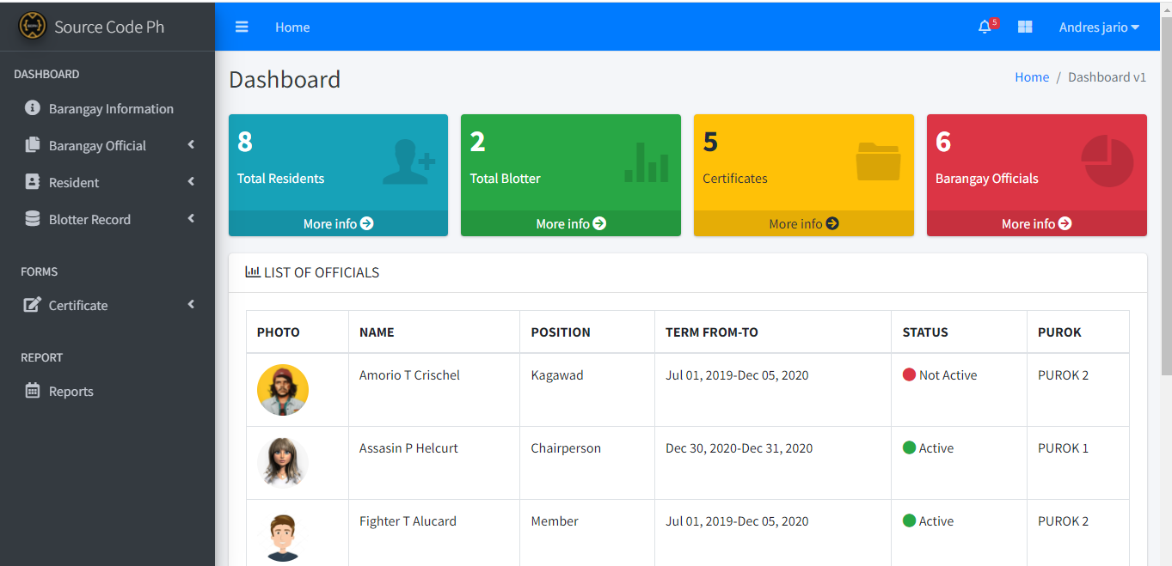
Created with a trial version of Syncfusion Essential Presentation
Created with a trial version of Syncfusion Essential Presentation
Created with a trial version of Syncfusion Essential Presentation
Created with a trial version of Syncfusion Essential Presentation
Created with a trial version of Syncfusion Essential Presentation
Created with a trial version of Syncfusion Essential Presentation
Created with a trial version of Syncfusion Essential Presentation
Created with a trial version of Syncfusion Essential Presentation
Created with a trial version of Syncfusion Essential Presentation
Created with a trial version of Syncfusion Essential Presentation
Created with a trial version of Syncfusion Essential Presentation
Created with a trial version of Syncfusion Essential Presentation
Created with a trial version of Syncfusion Essential Presentation
Created with a trial version of Syncfusion Essential Presentation
Created with a trial version of Syncfusion Essential Presentation
Created with a trial version of Syncfusion Essential Presentation
Created with a trial version of Syncfusion Essential Presentation
Created with a trial version of Syncfusion Essential Presentation
Created with a trial version of Syncfusion Essential Presentation
Created with a trial version of Syncfusion Essential Presentation
Created with a trial version of Syncfusion Essential Presentation
Created with a trial version of Syncfusion Essential Presentation
Created with a trial version of Syncfusion Essential Presentation
Created with a trial version of Syncfusion Essential Presentation
Created with a trial version of Syncfusion Essential Presentation
Created with a trial version of Syncfusion Essential Presentation
Created with a trial version of Syncfusion Essential Presentation
Created with a trial version of Syncfusion Essential Presentation
Created with a trial version of Syncfusion Essential Presentation
Created with a trial version of Syncfusion Essential Presentation
Created with a trial version of Syncfusion Essential Presentation
Created with a trial version of Syncfusion Essential Presentation
Created with a trial version of Syncfusion Essential Presentation
Created with a trial version of Syncfusion Essential Presentation
Created with a trial version of Syncfusion Essential Presentation
Created with a trial version of Syncfusion Essential Presentation
Created with a trial version of Syncfusion Essential Presentation
Created with a trial version of Syncfusion Essential Presentation
Created with a trial version of Syncfusion Essential Presentation
Created with a trial version of Syncfusion Essential Presentation
Created with a trial version of Syncfusion Essential Presentation
Created with a trial version of Syncfusion Essential Presentation
Created with a trial version of Syncfusion Essential Presentation
Created with a trial version of Syncfusion Essential Presentation
Created with a trial version of Syncfusion Essential Presentation
Created with a trial version of Syncfusion Essential Presentation
Created with a trial version of Syncfusion Essential Presentation
Created with a trial version of Syncfusion Essential Presentation
Created with a trial version of Syncfusion Essential Presentation
Created with a trial version of Syncfusion Essential Presentation
Created with a trial version of Syncfusion Essential Presentation
Created with a trial version of Syncfusion Essential Presentation
Created with a trial version of Syncfusion Essential Presentation
Created with a trial version of Syncfusion Essential Presentation
Created with a trial version of Syncfusion Essential Presentation
Created with a trial version of Syncfusion Essential Presentation
Created with a trial version of Syncfusion Essential Presentation

Slide 3
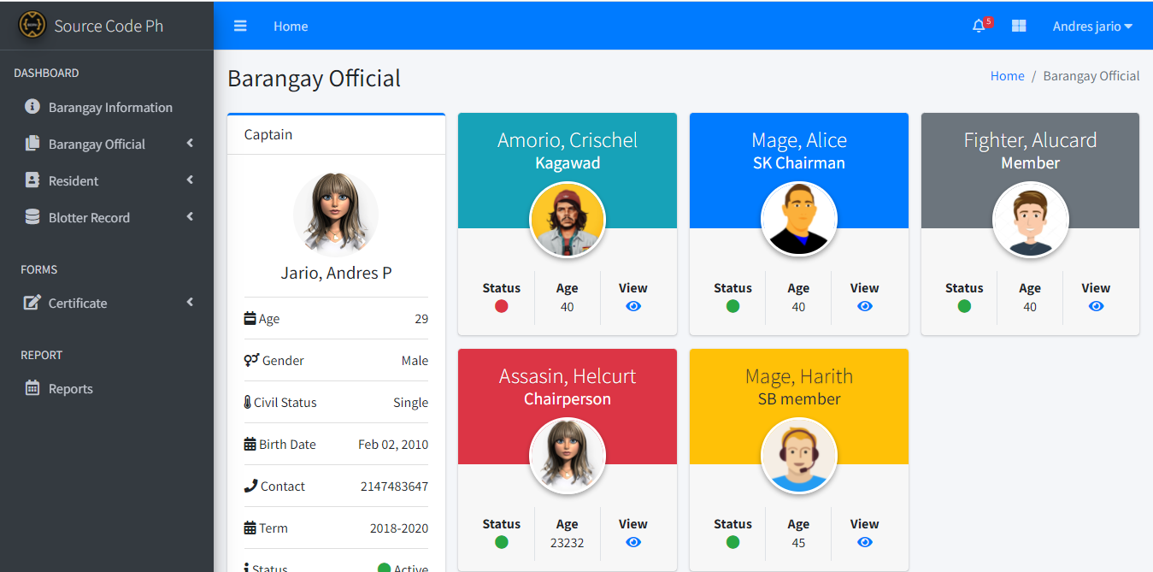
Created with a trial version of Syncfusion Essential Presentation
Created with a trial version of Syncfusion Essential Presentation
Created with a trial version of Syncfusion Essential Presentation
Created with a trial version of Syncfusion Essential Presentation
Created with a trial version of Syncfusion Essential Presentation
Created with a trial version of Syncfusion Essential Presentation
Created with a trial version of Syncfusion Essential Presentation
Created with a trial version of Syncfusion Essential Presentation
Created with a trial version of Syncfusion Essential Presentation
Created with a trial version of Syncfusion Essential Presentation
Created with a trial version of Syncfusion Essential Presentation
Created with a trial version of Syncfusion Essential Presentation
Created with a trial version of Syncfusion Essential Presentation
Created with a trial version of Syncfusion Essential Presentation
Created with a trial version of Syncfusion Essential Presentation
Created with a trial version of Syncfusion Essential Presentation
Created with a trial version of Syncfusion Essential Presentation
Created with a trial version of Syncfusion Essential Presentation
Created with a trial version of Syncfusion Essential Presentation
Created with a trial version of Syncfusion Essential Presentation
Created with a trial version of Syncfusion Essential Presentation
Created with a trial version of Syncfusion Essential Presentation
Created with a trial version of Syncfusion Essential Presentation
Created with a trial version of Syncfusion Essential Presentation
Created with a trial version of Syncfusion Essential Presentation
Created with a trial version of Syncfusion Essential Presentation
Created with a trial version of Syncfusion Essential Presentation
Created with a trial version of Syncfusion Essential Presentation
Created with a trial version of Syncfusion Essential Presentation
Created with a trial version of Syncfusion Essential Presentation
Created with a trial version of Syncfusion Essential Presentation
Created with a trial version of Syncfusion Essential Presentation
Created with a trial version of Syncfusion Essential Presentation
Created with a trial version of Syncfusion Essential Presentation
Created with a trial version of Syncfusion Essential Presentation
Created with a trial version of Syncfusion Essential Presentation
Created with a trial version of Syncfusion Essential Presentation
Created with a trial version of Syncfusion Essential Presentation
Created with a trial version of Syncfusion Essential Presentation
Created with a trial version of Syncfusion Essential Presentation
Created with a trial version of Syncfusion Essential Presentation
Created with a trial version of Syncfusion Essential Presentation
Created with a trial version of Syncfusion Essential Presentation
Created with a trial version of Syncfusion Essential Presentation
Created with a trial version of Syncfusion Essential Presentation
Created with a trial version of Syncfusion Essential Presentation
Created with a trial version of Syncfusion Essential Presentation
Created with a trial version of Syncfusion Essential Presentation
Created with a trial version of Syncfusion Essential Presentation
Created with a trial version of Syncfusion Essential Presentation
Created with a trial version of Syncfusion Essential Presentation
Created with a trial version of Syncfusion Essential Presentation
Created with a trial version of Syncfusion Essential Presentation
Created with a trial version of Syncfusion Essential Presentation
Created with a trial version of Syncfusion Essential Presentation
Created with a trial version of Syncfusion Essential Presentation
Created with a trial version of Syncfusion Essential Presentation

Slide 4
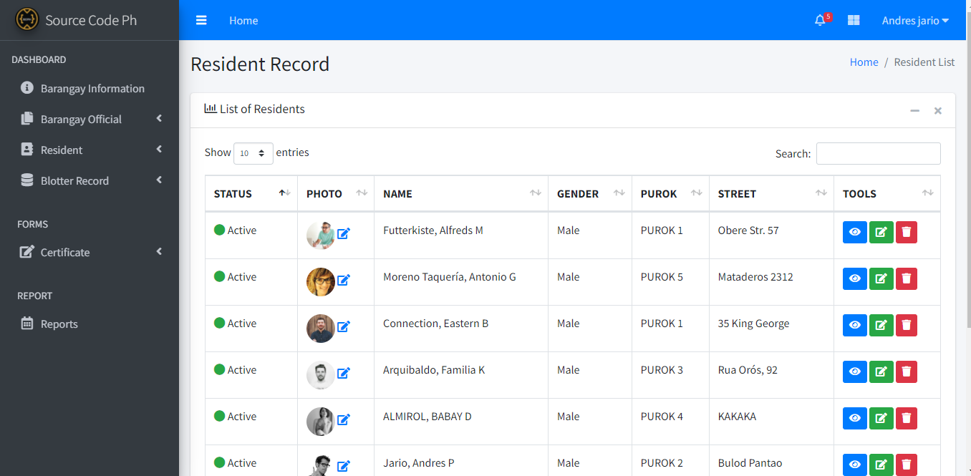
Created with a trial version of Syncfusion Essential Presentation
Created with a trial version of Syncfusion Essential Presentation
Created with a trial version of Syncfusion Essential Presentation
Created with a trial version of Syncfusion Essential Presentation
Created with a trial version of Syncfusion Essential Presentation
Created with a trial version of Syncfusion Essential Presentation
Created with a trial version of Syncfusion Essential Presentation
Created with a trial version of Syncfusion Essential Presentation
Created with a trial version of Syncfusion Essential Presentation
Created with a trial version of Syncfusion Essential Presentation
Created with a trial version of Syncfusion Essential Presentation
Created with a trial version of Syncfusion Essential Presentation
Created with a trial version of Syncfusion Essential Presentation
Created with a trial version of Syncfusion Essential Presentation
Created with a trial version of Syncfusion Essential Presentation
Created with a trial version of Syncfusion Essential Presentation
Created with a trial version of Syncfusion Essential Presentation
Created with a trial version of Syncfusion Essential Presentation
Created with a trial version of Syncfusion Essential Presentation
Created with a trial version of Syncfusion Essential Presentation
Created with a trial version of Syncfusion Essential Presentation
Created with a trial version of Syncfusion Essential Presentation
Created with a trial version of Syncfusion Essential Presentation
Created with a trial version of Syncfusion Essential Presentation
Created with a trial version of Syncfusion Essential Presentation
Created with a trial version of Syncfusion Essential Presentation
Created with a trial version of Syncfusion Essential Presentation
Created with a trial version of Syncfusion Essential Presentation
Created with a trial version of Syncfusion Essential Presentation
Created with a trial version of Syncfusion Essential Presentation
Created with a trial version of Syncfusion Essential Presentation
Created with a trial version of Syncfusion Essential Presentation
Created with a trial version of Syncfusion Essential Presentation
Created with a trial version of Syncfusion Essential Presentation
Created with a trial version of Syncfusion Essential Presentation
Created with a trial version of Syncfusion Essential Presentation
Created with a trial version of Syncfusion Essential Presentation
Created with a trial version of Syncfusion Essential Presentation
Created with a trial version of Syncfusion Essential Presentation
Created with a trial version of Syncfusion Essential Presentation
Created with a trial version of Syncfusion Essential Presentation
Created with a trial version of Syncfusion Essential Presentation
Created with a trial version of Syncfusion Essential Presentation
Created with a trial version of Syncfusion Essential Presentation
Created with a trial version of Syncfusion Essential Presentation
Created with a trial version of Syncfusion Essential Presentation
Created with a trial version of Syncfusion Essential Presentation
Created with a trial version of Syncfusion Essential Presentation
Created with a trial version of Syncfusion Essential Presentation
Created with a trial version of Syncfusion Essential Presentation
Created with a trial version of Syncfusion Essential Presentation
Created with a trial version of Syncfusion Essential Presentation
Created with a trial version of Syncfusion Essential Presentation
Created with a trial version of Syncfusion Essential Presentation
Created with a trial version of Syncfusion Essential Presentation
Created with a trial version of Syncfusion Essential Presentation
Created with a trial version of Syncfusion Essential Presentation

Slide 5
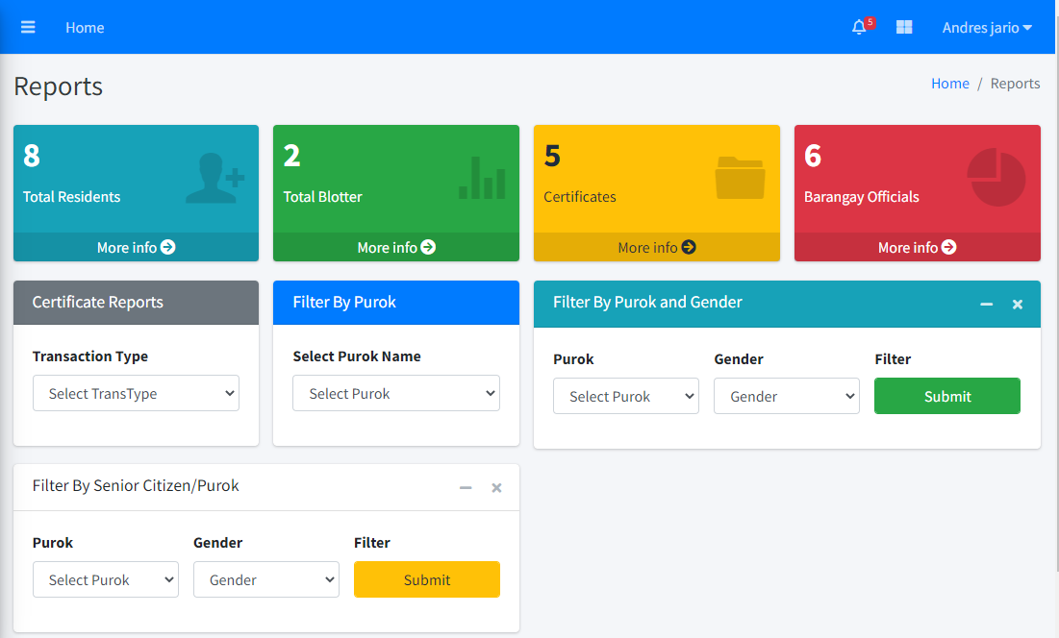
Created with a trial version of Syncfusion Essential Presentation
Created with a trial version of Syncfusion Essential Presentation
Created with a trial version of Syncfusion Essential Presentation
Created with a trial version of Syncfusion Essential Presentation
Created with a trial version of Syncfusion Essential Presentation
Created with a trial version of Syncfusion Essential Presentation
Created with a trial version of Syncfusion Essential Presentation
Created with a trial version of Syncfusion Essential Presentation
Created with a trial version of Syncfusion Essential Presentation
Created with a trial version of Syncfusion Essential Presentation
Created with a trial version of Syncfusion Essential Presentation
Created with a trial version of Syncfusion Essential Presentation
Created with a trial version of Syncfusion Essential Presentation
Created with a trial version of Syncfusion Essential Presentation
Created with a trial version of Syncfusion Essential Presentation
Created with a trial version of Syncfusion Essential Presentation
Created with a trial version of Syncfusion Essential Presentation
Created with a trial version of Syncfusion Essential Presentation
Created with a trial version of Syncfusion Essential Presentation
Created with a trial version of Syncfusion Essential Presentation
Created with a trial version of Syncfusion Essential Presentation
Created with a trial version of Syncfusion Essential Presentation
Created with a trial version of Syncfusion Essential Presentation
Created with a trial version of Syncfusion Essential Presentation
Created with a trial version of Syncfusion Essential Presentation
Created with a trial version of Syncfusion Essential Presentation
Created with a trial version of Syncfusion Essential Presentation
Created with a trial version of Syncfusion Essential Presentation
Created with a trial version of Syncfusion Essential Presentation
Created with a trial version of Syncfusion Essential Presentation
Created with a trial version of Syncfusion Essential Presentation
Created with a trial version of Syncfusion Essential Presentation
Created with a trial version of Syncfusion Essential Presentation
Created with a trial version of Syncfusion Essential Presentation
Created with a trial version of Syncfusion Essential Presentation
Created with a trial version of Syncfusion Essential Presentation
Created with a trial version of Syncfusion Essential Presentation
Created with a trial version of Syncfusion Essential Presentation
Created with a trial version of Syncfusion Essential Presentation
Created with a trial version of Syncfusion Essential Presentation
Created with a trial version of Syncfusion Essential Presentation
Created with a trial version of Syncfusion Essential Presentation
Created with a trial version of Syncfusion Essential Presentation
Created with a trial version of Syncfusion Essential Presentation
Created with a trial version of Syncfusion Essential Presentation
Created with a trial version of Syncfusion Essential Presentation
Created with a trial version of Syncfusion Essential Presentation
Created with a trial version of Syncfusion Essential Presentation
Created with a trial version of Syncfusion Essential Presentation
Created with a trial version of Syncfusion Essential Presentation
Created with a trial version of Syncfusion Essential Presentation
Created with a trial version of Syncfusion Essential Presentation
Created with a trial version of Syncfusion Essential Presentation
Created with a trial version of Syncfusion Essential Presentation
Created with a trial version of Syncfusion Essential Presentation
Created with a trial version of Syncfusion Essential Presentation
Created with a trial version of Syncfusion Essential Presentation

